Slide 1
E6156 – Topics in SW Engineering: Cloud Computing
Lecture 8: Cool Stuff
© Donald F. Ferguson, 2022

Slide 2

Shared spreadsheet? Why me?

Slide 3

Stateless, Sessions Example
3 | E6156 – Topics in SW Engineering – Lecture 8: Service Composition, Calling APIs, Events
© Donald F. Ferguson, 2022

Slide 4
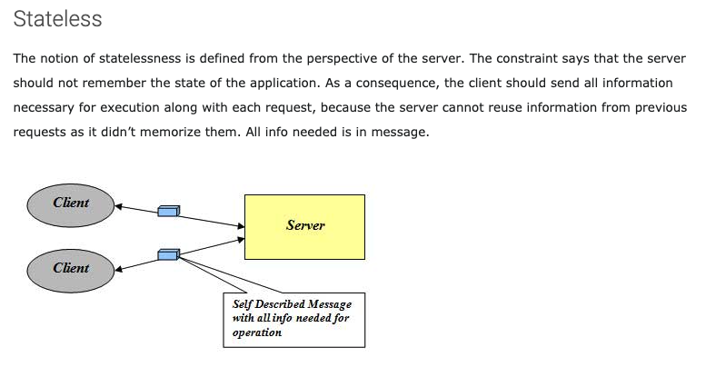
Stateless
http://mrbool.com/rest-architectural-elements-and-constraints/29339

Slide 5
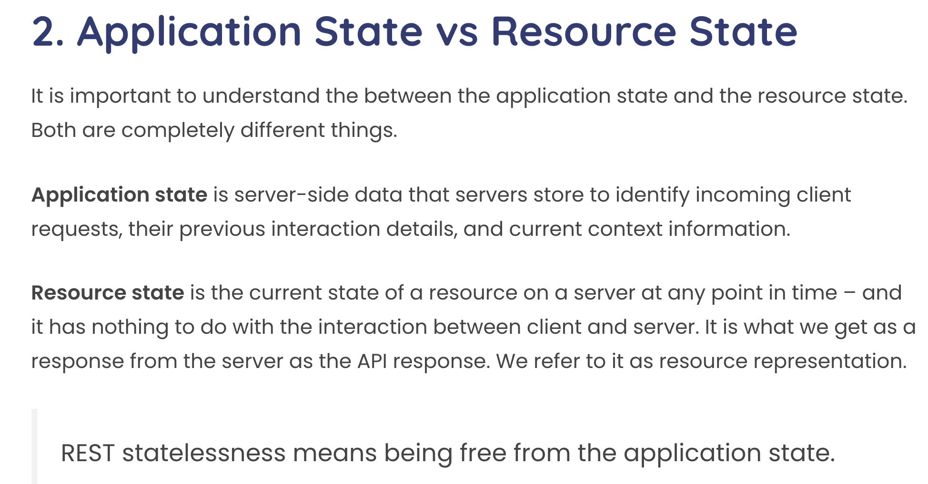
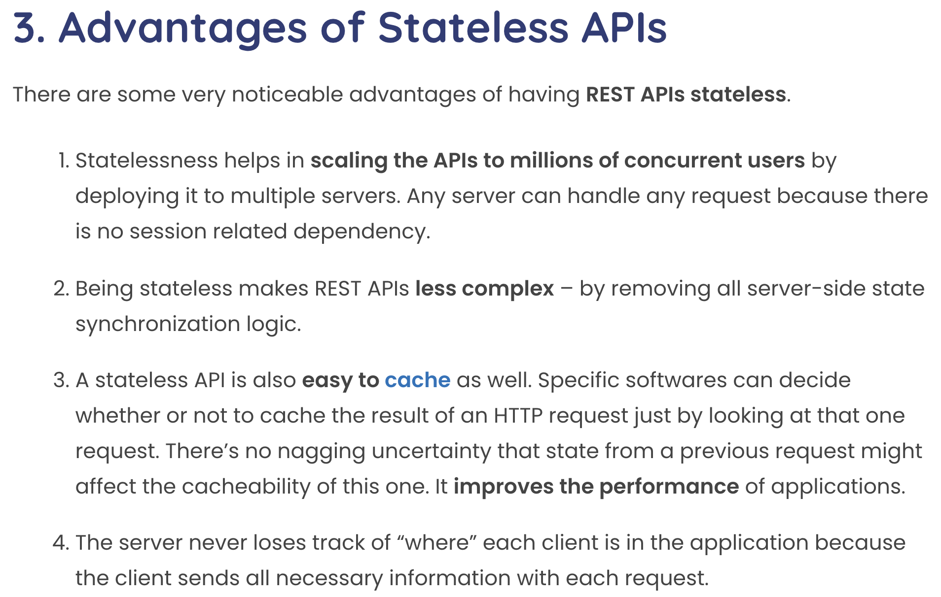
Statelessness
This concept can be confusing with experience with other approach to session state.
Some application frameworks did/do keep session state on the server.
Application servers and frameworks have various support for “session state,” e.g. https://flask-session.readthedocs.io/en/latest/

Slide 6
Simple Example from Databases
“In computer science, a database cursor is a mechanism that enables traversal over the records in a database. Cursors facilitate subsequent processing in conjunction with the traversal, such as retrieval, addition and removal of database records. The database cursor characteristic of traversal makes cursors akin to the programming language concept of iterator.” (https://en.wikipedia.org/wiki/Cursor_(databases))
Database Server
create_cursor()
fetch()
fetch()
close()
Cursor
... ...
... ...
Client Application
Cursor
Database Server
The client and database server share the “state of the cursor.”
This is separate from the state of the data.
This hinders scalability and fault tolerance if there are multiple database servers in a cluster.

Slide 7
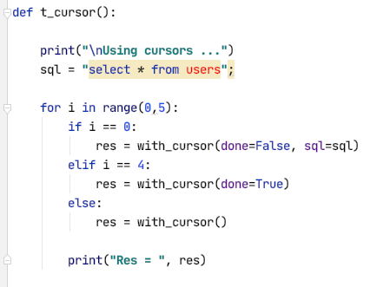
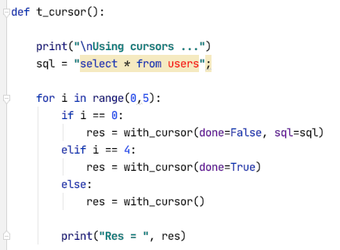
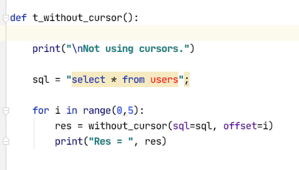
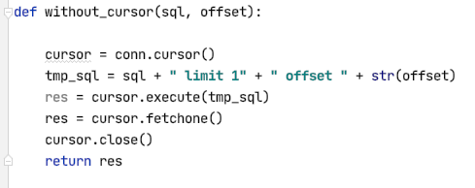
Some Code

Slide 8
Calling APIs
8 | E6156 – Topics in SW Engineering – Lecture 8: Service Composition, Calling APIs, Events
© Donald F. Ferguson, 2022

Slide 9
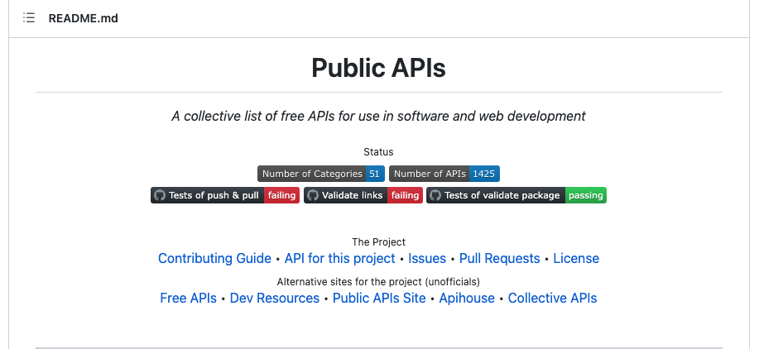
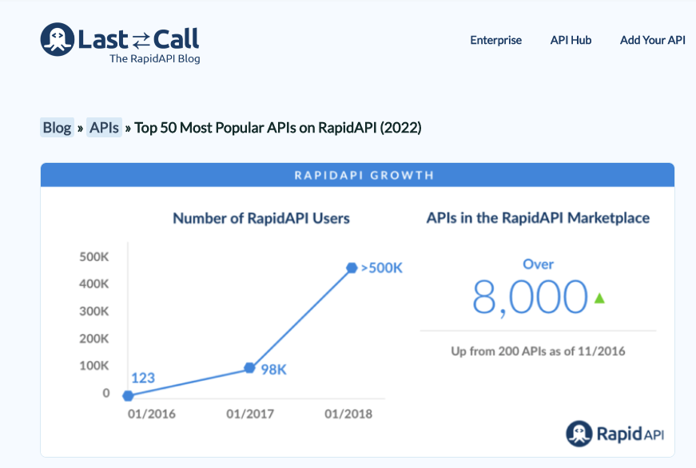
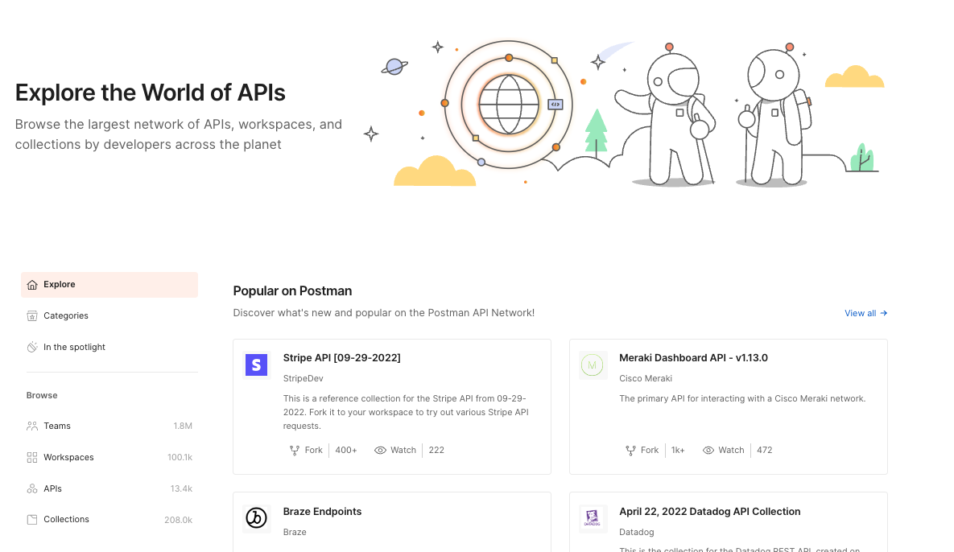
A World of APIs

Slide 10
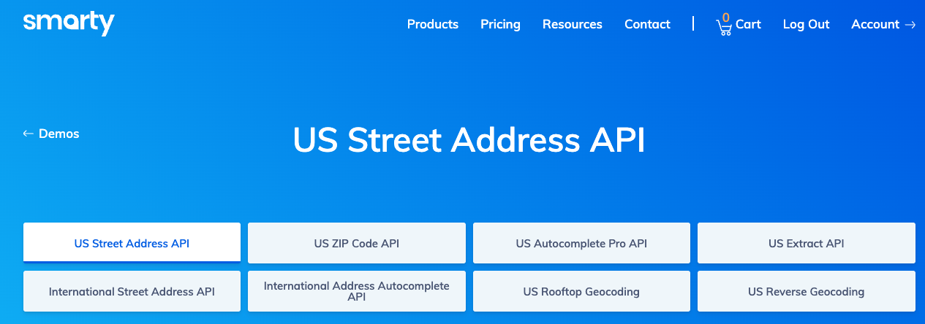
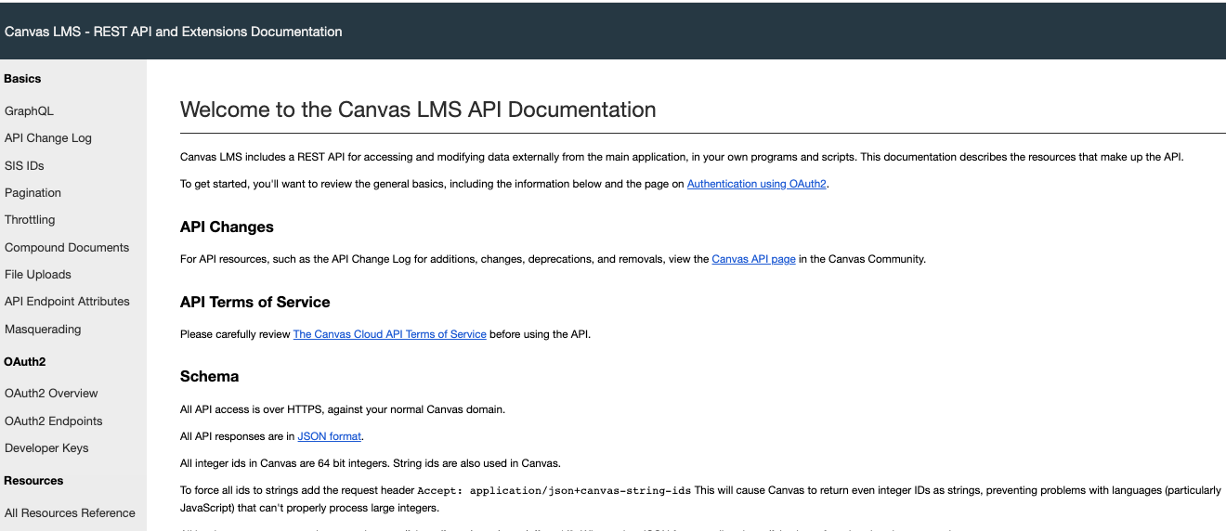
Two APIs I Use in My Project
Addresses:
People are really bad at entering mailing addresses.
520 w 120th st NYC
520 West 120 St New York, NY
… …
We want a canonical, verified representation.
CourseWorks
Students will access my web application to set up projects, teams, …
I want to verify that students are in the class, and keep list of students up to date.

Slide 11
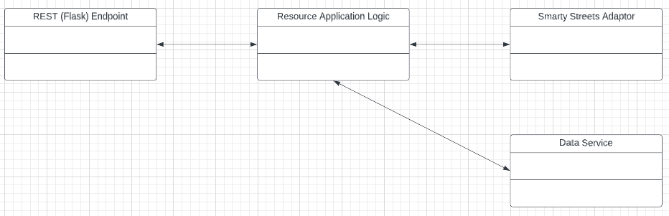
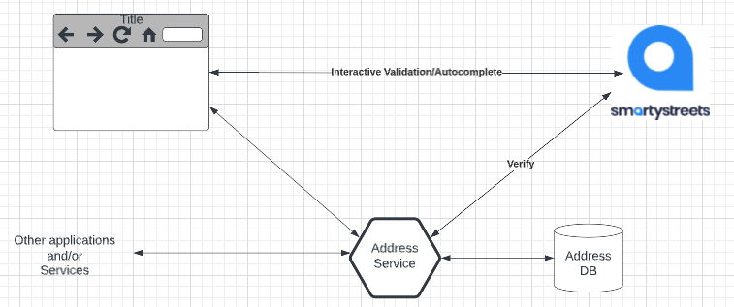
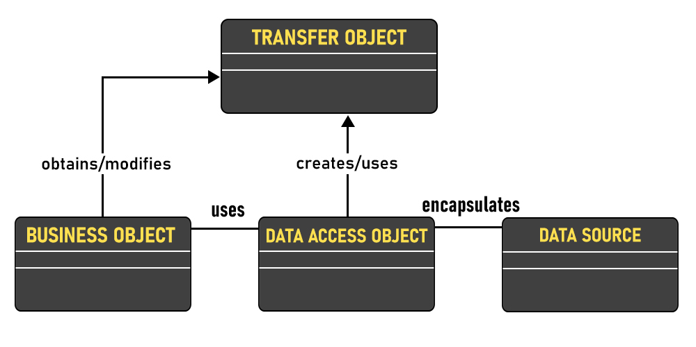
Address Example
Microservice Implementation
Receive JSON body in PUT/POST.
Call API to verify.
If verified, save in DB.
URL path is the delivery point
Zipcode
Zip plus 4
Delivery point
Use autocomplete functions to help users correctly enter addresses https://jsfiddle.net/smartystreets/j1Lq5say
But, … …
A microservice cannot assume that a valid UI is calling the service.
It must support any UI or endpoint authorized to call the service.
So, we will also validate in the microservice implementation.
Example code walkthrough and online tools.

Slide 13
Synchronous versus Asynchronous
13 | E6156 – Topics in SW Engineering – Lecture 8: Service Composition, Calling APIs, Events
© Donald F. Ferguson, 2022

Slide 14
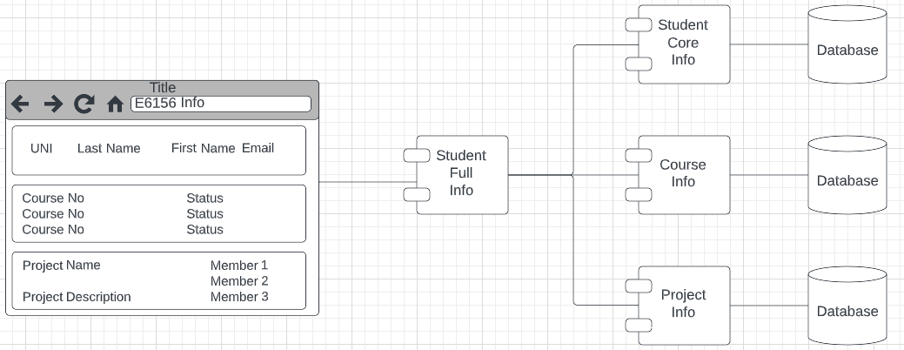
Synchronous versus Asynchronous
CRUD on composite service StudentFullInfo requires CRUD on 3 microservices.
There are two styles for calling the component (composed services)
Synchronous, one after another, waiting each time.
Asynchronous: Call all three in parallel, and ”gather the answer.”

Slide 15
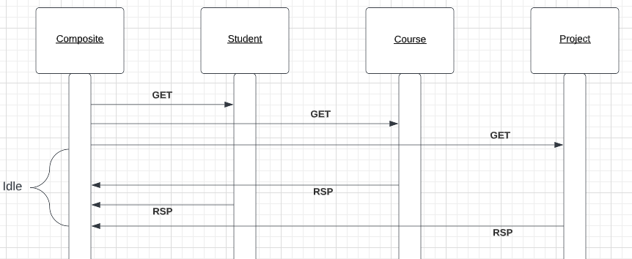
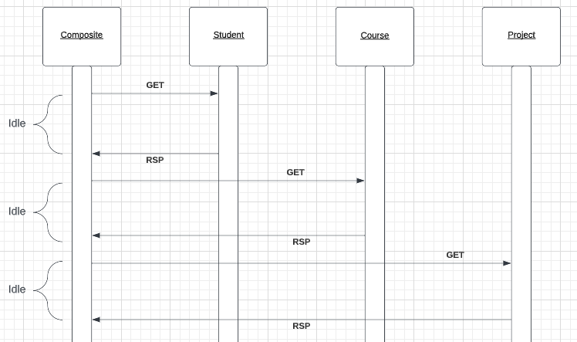
Synchronous versus Asynchronous
Synchronous
Asynchronous
Show code from:
call_urls_synch_asynch
async3
async_p_mysql
Async-python
av_requests
av_async_run
The elapsed time for calling synchronous is the sum of the calls’ response times.
The elapsed time for calling asynchronous is the maximum response time of the 3 calls.
Asynchronous:
Has better elapsed times and less “application is idle waiting” time, but
The logic is more complex, especially if the composite services has to “undo” some calls because others failed.

Slide 16
Concurrency
A running program executes in an operating system process. There are many approaches to concurrency:
Multiprocessing:
The system has several “active processes.”
Only one process is executing on a CPU (core) as a time.
The OS switches between processes when the running process performs a blocking operations, e.g. file IO, remote network call, ... ...
Multithreading:
There are several “active threads” within a process.
(Usually) Only one thread is executing on a CPU (core) at a time.
When the thread performs a blocking operation, the process continues to run but executes a different, ready thread.
Coroutines:
There is a single active thread within a process.
When a thread performs a blocking operation, the programming language runtime does weird internal stuff
Makes a copy of the current coroutines environment (call stack, ... ...)
Starts a ready coroutine by switching to its call stack and next statement.
The thread and process do not block.
A context switch is changing the currently running process, thread or task.
There is a performance overhead for a context switch.
Overhead(multiprocessing) >> Overhead(multithreading) >> Overhead(coroutines)

Slide 17
Threads, Promises, Asynch Functions, ... ...
https://medium.com/@amragaey/shortly-how-node-js-works-on-a-single-thread-763fda99f012
Callbacks
Incoming requests map to an event.
There is a single thread running application code associated with an event..
Long running calls get assigned to a separate worker thread, and register a callback.
Completion of an operation results in an event, which resumes the application via a callback.
https://en.wikipedia.org/wiki/Multithreading_(computer_architecture)
Multithreading
Thread #1 “blocks” for an IO or API call.
Process switches to “ready” thread #2

Slide 18
Service Composition
18 | E6156 – Topics in SW Engineering – Lecture 8: Service Composition, Calling APIs, Events
© Donald F. Ferguson, 2022

Slide 19
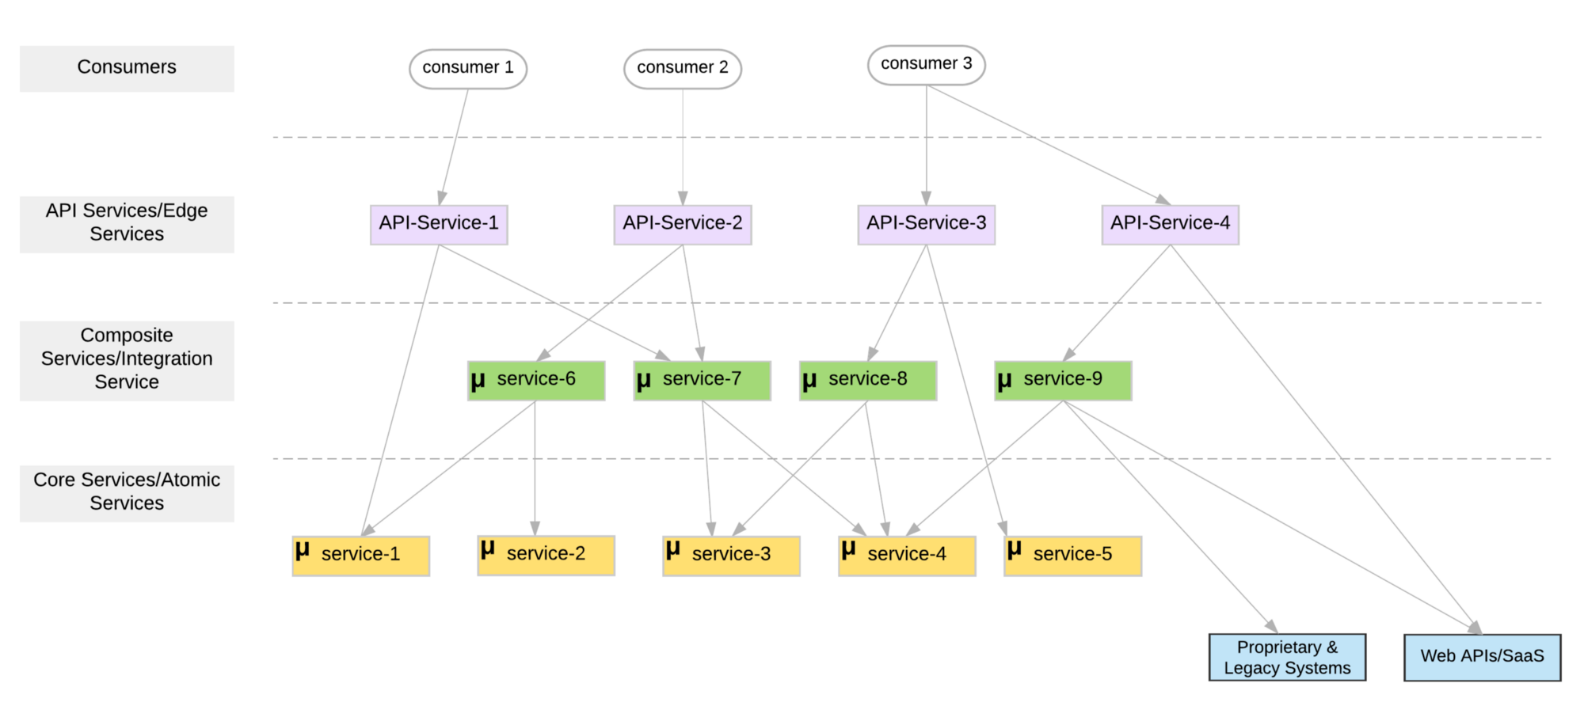
Microservice Layers

Slide 20
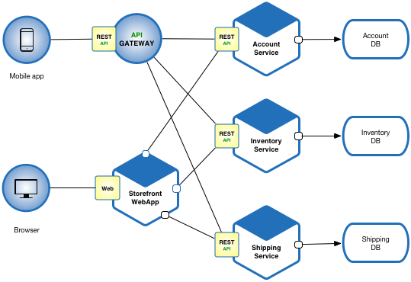
Another View

Slide 21
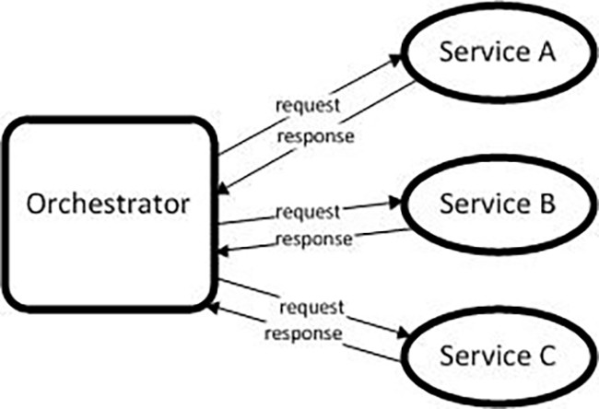
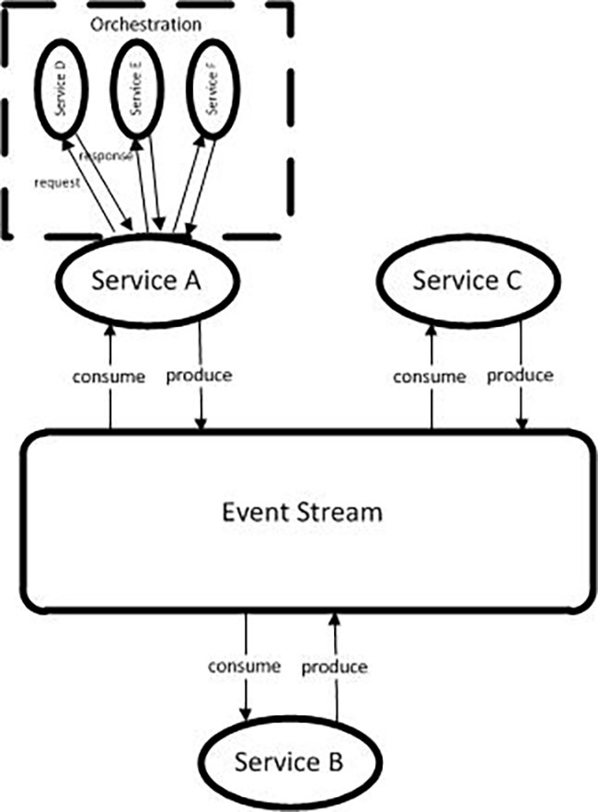
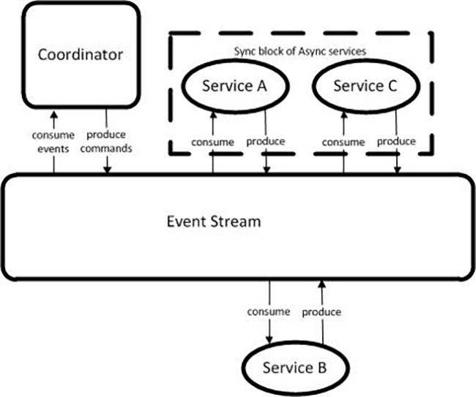
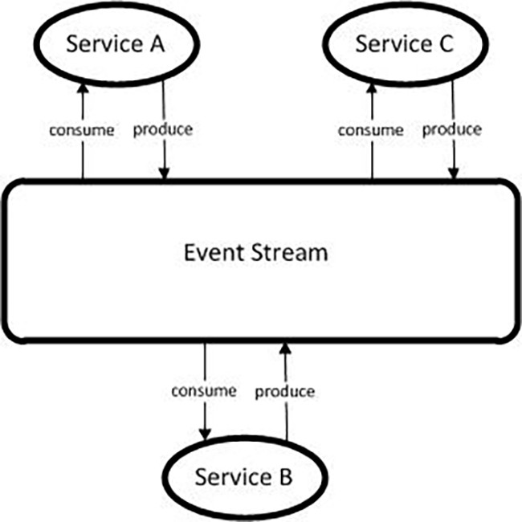
Models (https://medium.com/capital-one-tech/microservices-when-to-react-vs-orchestrate-c6b18308a14c)

Slide 22
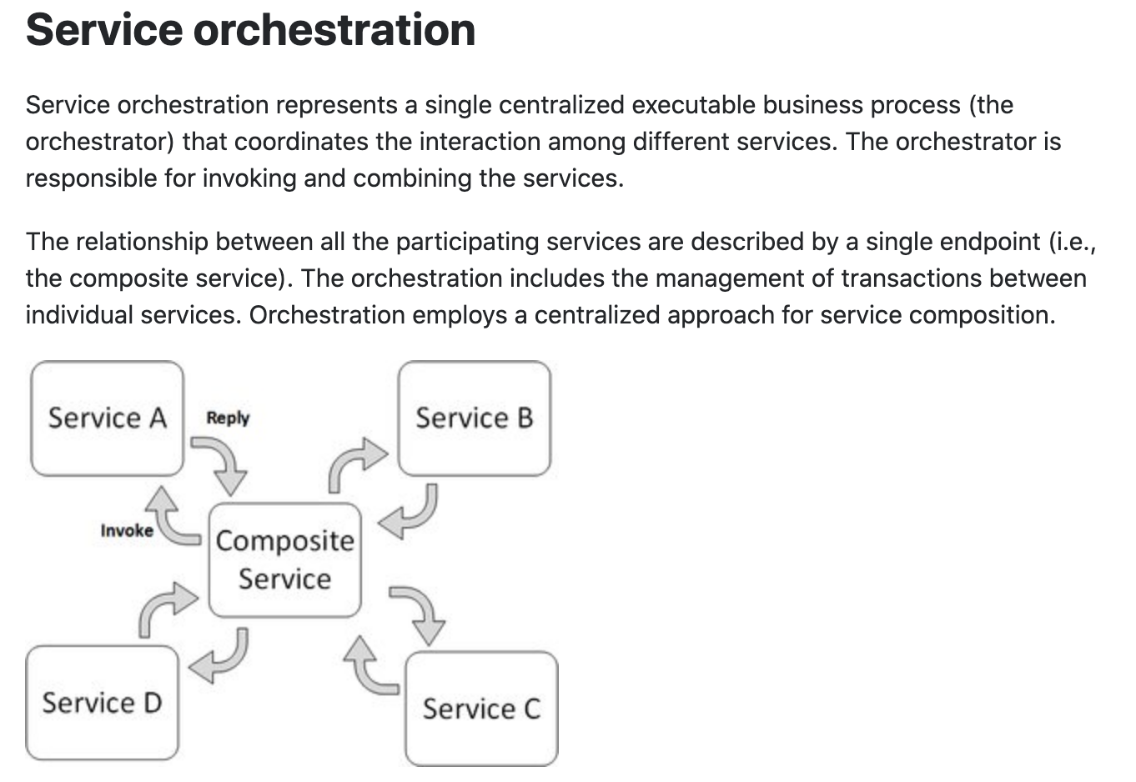
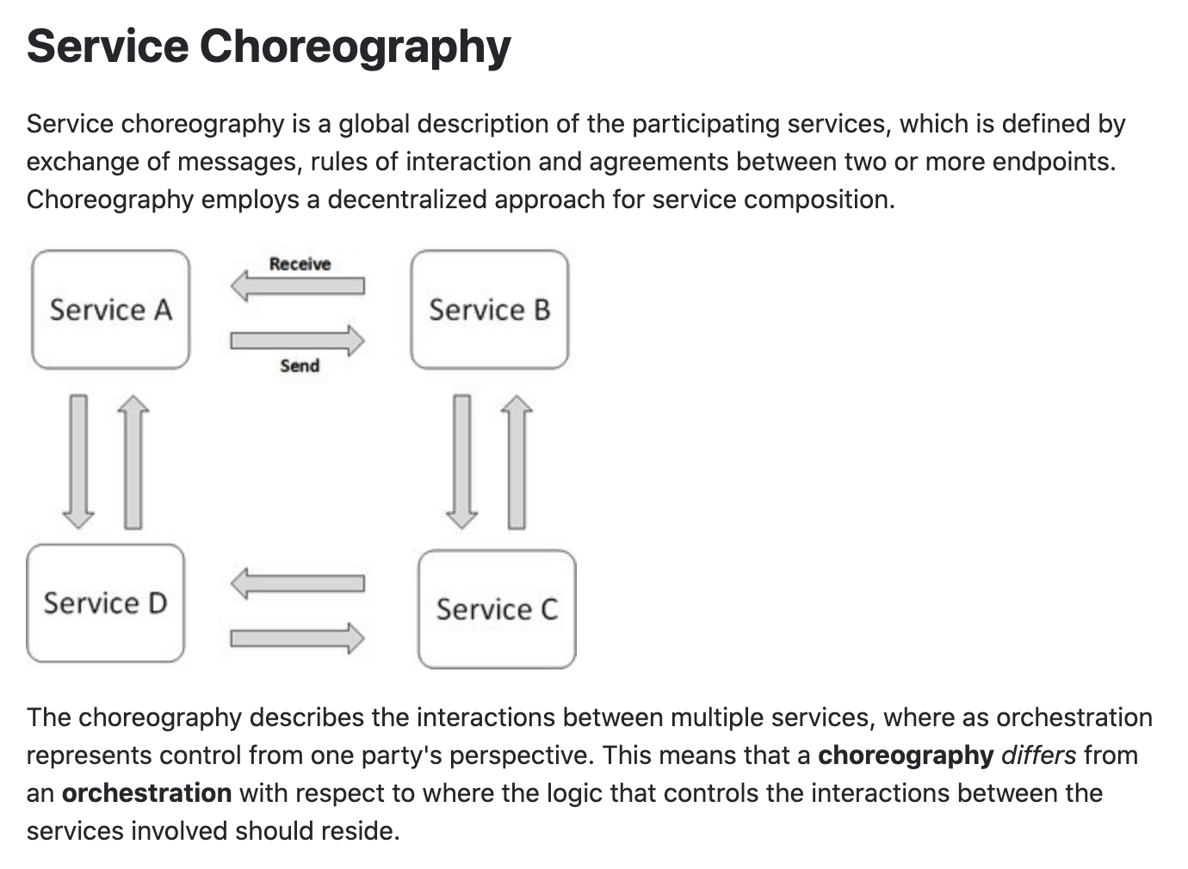
Concepts
These are not formally, rigorously defined terms.

Slide 23
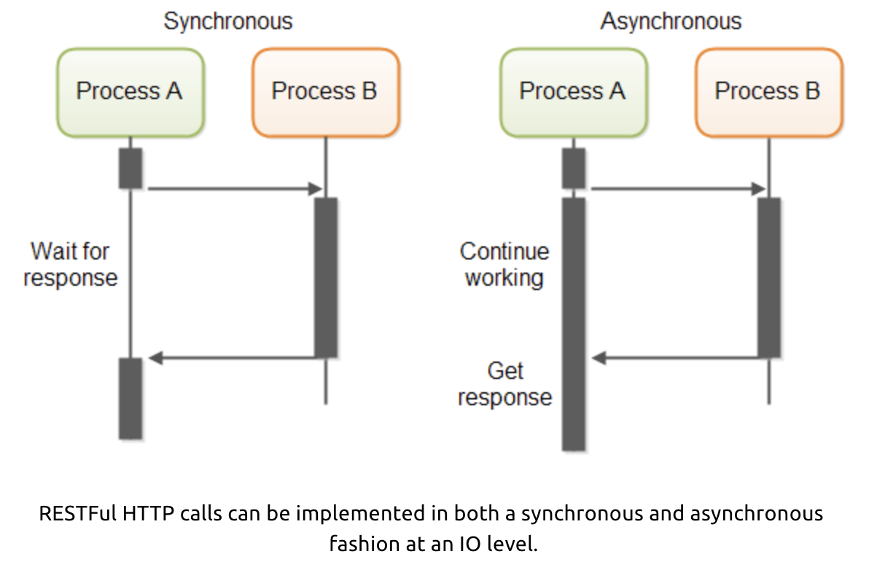
Service Orchestration/Composition
One call to a composite service
May drive calls to multiple other services.
Which in turn, may drive multiple calls to other services.
Synchronous (Wait) and calling one at a time, in order is
Inefficient
Fragile
... ...
Asynchronous has benefits but can result in complex code.

Slide 24
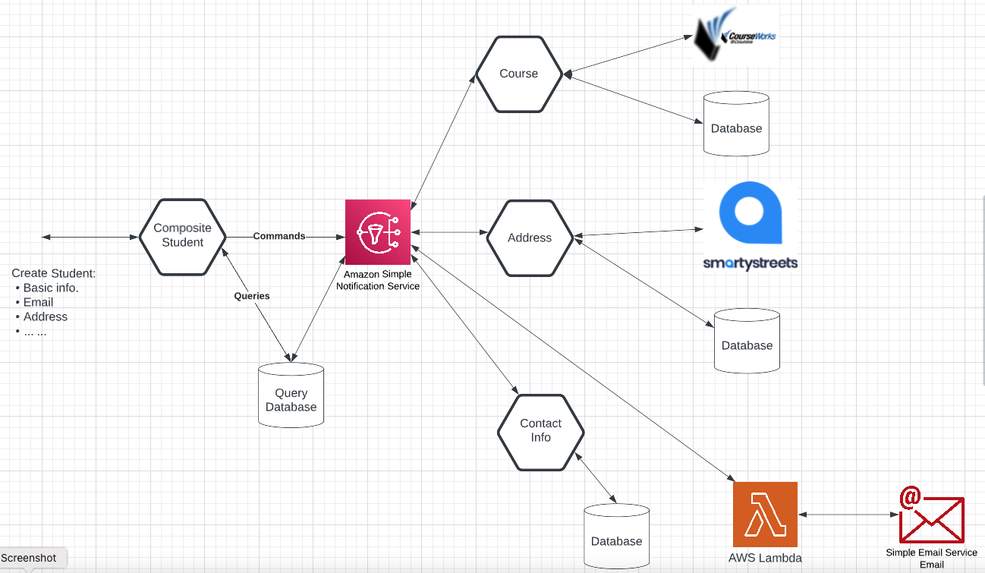
What I (We) Will Implement

Slide 25
Middleware
25 | E6156 – Topics in SW Engineering – Lecture 8: Service Composition, Calling APIs, Events
© Donald F. Ferguson, 2022

Slide 26
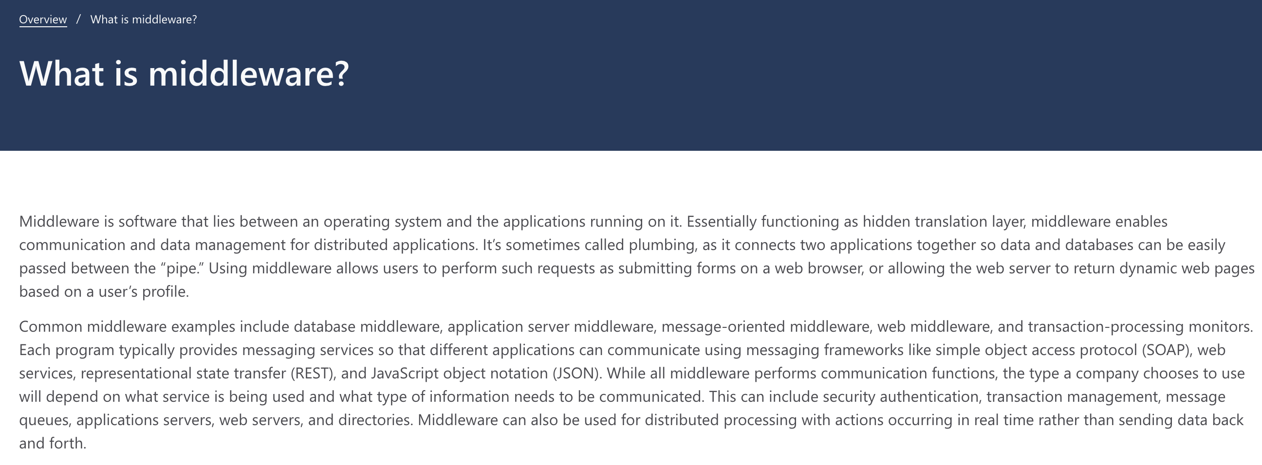
Middleware

Slide 27
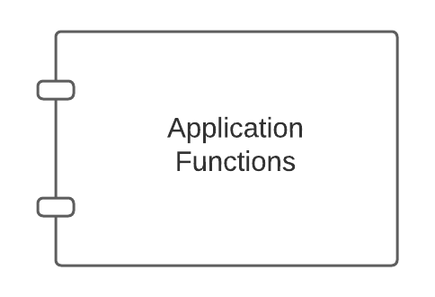
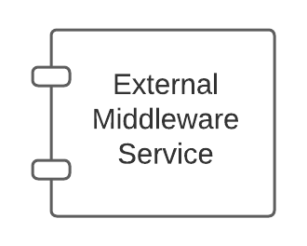
Middleware – Conceptual Model
Middleware:
Application might call directly, e.g. DB
May be implicitly called as part of request processing, e.g. logging.

Slide 28
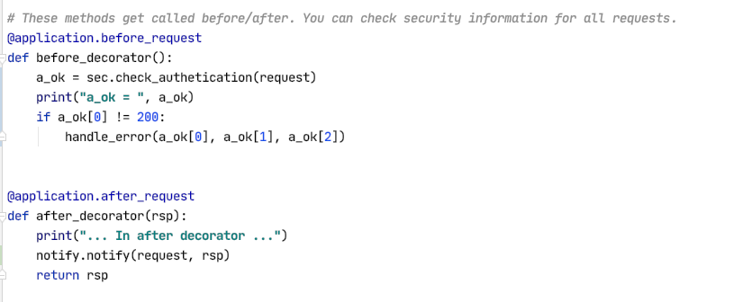
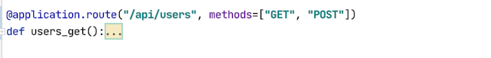
Middleware and Flask
White list of URLs
If not on white list:
Verify token
Verify authorization
List of filters of the form:
URL
HTTP Method
SNS topic to use
Send an event to SNS if matches filter
Show some demo code.

Slide 29
So, How Will We Use This?
Add before_request and after_request to microservices. (Note: There are other approaches).
Implement two middleware interceptors:
Security
Configured with a JSON file.
File lists which {path, method} not being logged on.
While IDs can perform which methods on which paths.
Automates driving login redirect (401 – Unauthorized)
Checks authorization (403– Forbidden)
Notification:
Configured with JSON in environment variables.
File lists which operations emit a before and/or after event to an SNS topic.
We will use notification to drive some other things like webhooks.
I will demo middleware and webhook today.
Your project will use middleware and SNS.

Slide 30
Cloud Identity (Open ID, OAuth2, ... ...) Reminder
/Users/donaldferguson/Dropbox/00NewProjects/google_login
30 | E6156 – Topics in SW Engineering – Lecture 8: Service Composition, Calling APIs, Events
© Donald F. Ferguson, 2022

Slide 31
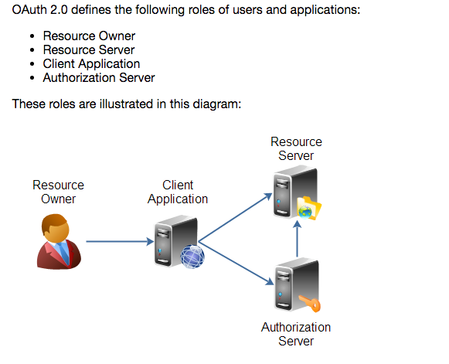
Overview (http://tutorials.jenkov.com/oauth2/index.html)
Resource Owner
Controls access to the “data.”
Facebook user, LinkedIn user, …
Resource Server
The website that holds/manages info.
Facebook, LinkedIn, ...
And provides access API.
Client Application
“The product you implemented.”
Wants to read/update
“On your behalf”
The data the data that the Resource Server maintains, e.g. posts, status, tweets, ...
Authorization Server
Grants/rejects authorization
Based on Resource Owner decisions.
Usually (logically) the same as Resource Server.

Slide 32
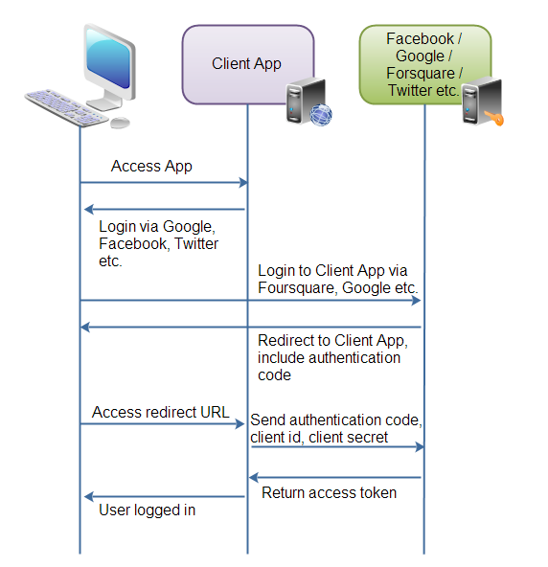
Roles/Flows
User Clicks “Logon with XXX”
Redirect user to XXX
With Client App application ID.
And permissions app requests.
Code MAY have to call Resource Server to get a token to include in redirect URL.
Browser redirected to XXX
Logon on to XXX prompt.
Followed by “do you grant permission to …”
Clicking button drives a redirect back to Client App. URL contains a temporary token.
User/Browser
Redirected to Client App URL with token.
Client App calls XXX API
Obtains access token.
Returns to User.
Client App can use access token on API calls.

Slide 33
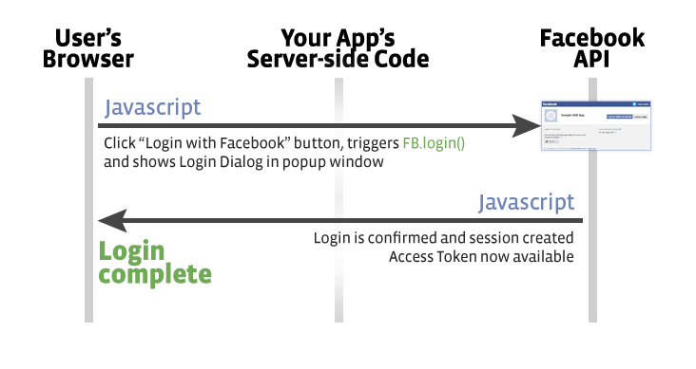
Facebook
Validate Token/Get Info
Register(Token)
OK
Save Data

Slide 34
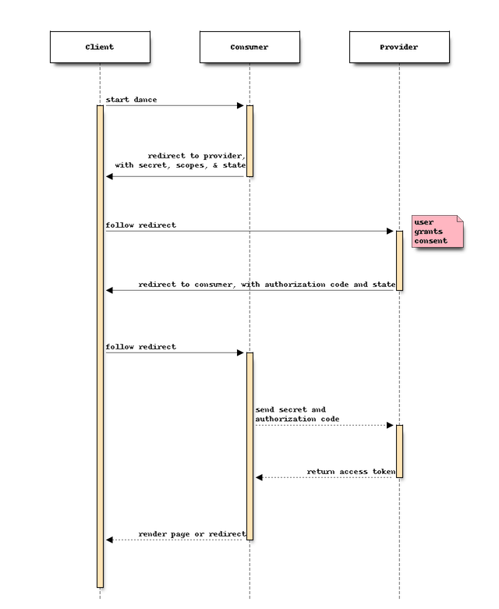
Walkthrough: Middleware and Security
Explain why I have to go incognito.
Show:
Project code ... ...
GCP application registration page.
Token in the header (Postman)
I normally do these things explicitly in my code.
I used Facebook in the past.
I decided to use Google because I expect people using my team management application to have Lionmail/Google accounts.
For expediency, I used Flask-Dance (https://flask-dance.readthedocs.io/en/latest/)
I understand the magic in general, but ...
I have not yet “learned the flask-dance magic” and how it uses the protocol under the hood.
The net is:
OAuth2 is about authorization, but ...
Getting the basic profile proves authentication
And, I can use to simplify the registration process.

Slide 35
To Show
Code walkthrough.
Cookie/header.
Certificate.
… …

Slide 36
Event Drive Processing Publish/Subscribe
36 | E6156 – Topics in SW Engineering – Lecture 8: Service Composition, Calling APIs, Events
© Donald F. Ferguson, 2022

Slide 37
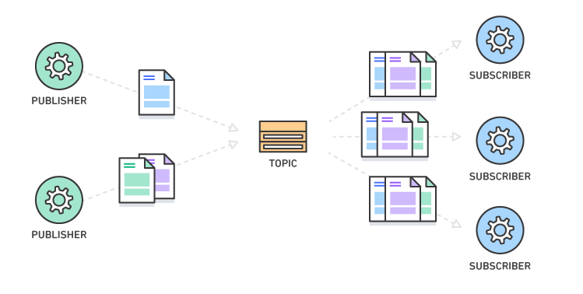
Pub/Sub – Event Driven Processing
“In software architecture, publish–subscribe is a messaging pattern where senders of messages, called publishers, do not program the messages to be sent directly to specific receivers, called subscribers, but instead categorize published messages into classes without knowledge of which subscribers, if any, there may be. Similarly, subscribers express interest in one or more classes and only receive messages that are of interest, without knowledge of which publishers, if any, there are.
Publish–subscribe is a sibling of the message queue paradigm, and is typically one part of a larger message-oriented middleware system. Most messaging systems support both the pub/sub and message queue models in their API, e.g. Java Message Service (JMS).
This pattern provides greater network scalability and a more dynamic network topology, with a resulting decreased flexibility to modify the publisher and the structure of the published data.”
For microservices:
It support loose coupling for application evolution and agility.
I can add and evolve services without modifying the the base services.
For example,
If creating a customer service calls “send an email.”
I have to modify the original code to add support for SMS, webhook, etc.
With EDA, I just add or modify subscriptions.
https://en.wikipedia.org/wiki/Publish%E2%80%93subscribe_pattern
37 | E6156 – Topics in SW Engineering: Lecture 6: Middleware, APIGW, Lambda, SSO, Events © Donald F. Ferguson, 2021

Slide 38
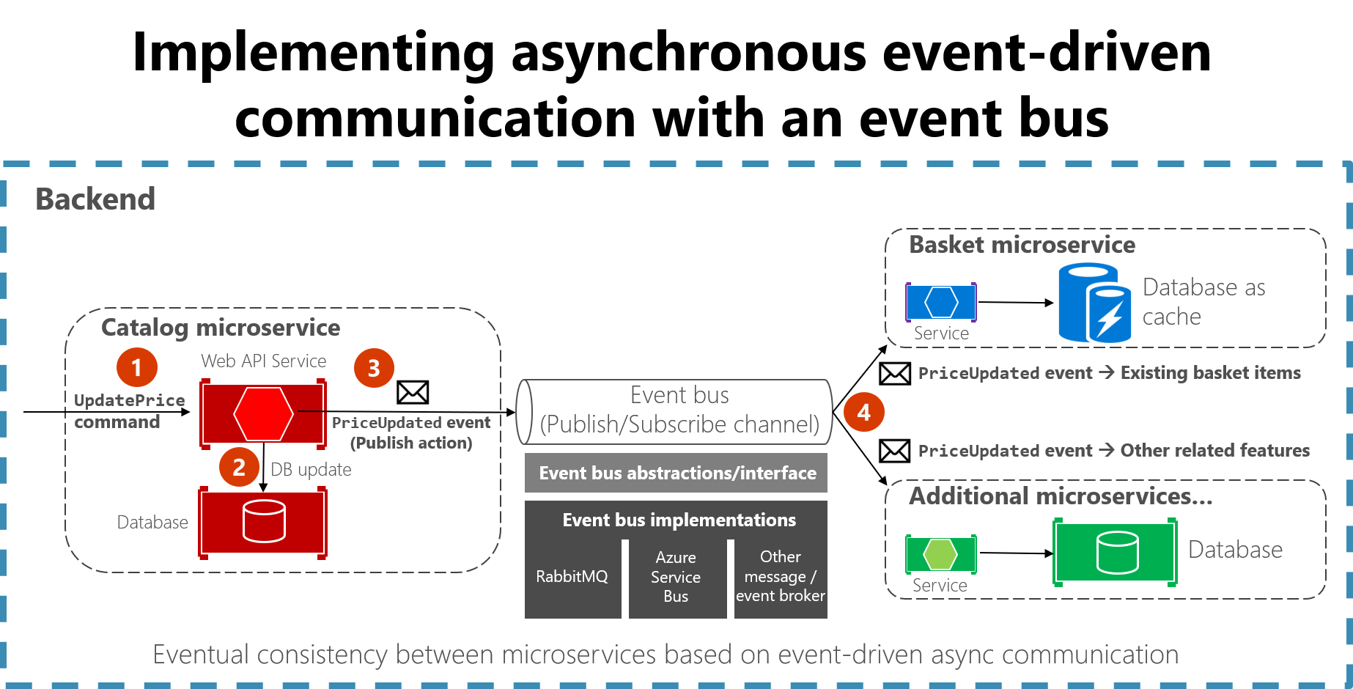
Concept
https://docs.microsoft.com/en-us/dotnet/architecture/microservices/multi-container-microservice-net-applications/integration-event-based-microservice-communications

Slide 40
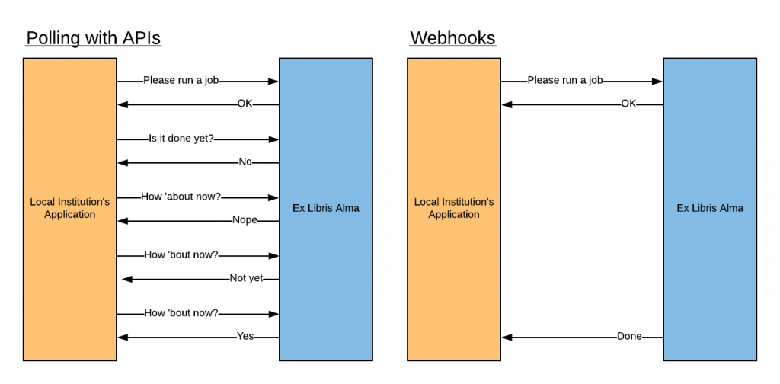
Webhooks
“A webhook in web development is a method of augmenting or altering the behavior of a web page or web application with custom callbacks. These callbacks may be maintained, modified, and managed by third-party users and developers who may not necessarily be affiliated with the originating website or application. The term "webhook" was coined by Jeff Lindsay in 2007 from the computer programming term hook.”

Slide 41
Function-as-a-Service
41 | E6156 – Topics in SW Engineering: Lecture 6: Middleware, APIGW, Lambda, SSO, Events © Donald F. Ferguson, 2021

Slide 42
Serverless and Function-as-a-Service
Serverless computing is a cloud computing execution model in which the cloud provider runs the server, and dynamically manages the allocation of machine resources. Pricing is based on the actual amount of resources consumed by an application, rather than on pre-purchased units of capacity.^{[1]} It can be a form of utility computing. Serverless computing can simplify the process of deploying code into production. Scaling, capacity planning and maintenance operations may be hidden from the developer or operator. Serverless code can be used in conjunction with code deployed in traditional styles, such as microservices. Alternatively, applications can be written to be purely serverless and use no provisioned servers at all.^{[2]} This should not be confused with computing or networking models that do not require an actual server to function, such as peer-to-peer (P2P).”
Function as a service (FaaS) is a category of cloud computing services that provides a platform allowing customers to develop, run, and manage application functionalities without the complexity of building and maintaining the infrastructure typically associated with developing and launching an app.^{[1]} Building an application following this model is one way of achieving a "serverless" architecture, and is typically used when building microservices applications.”
That was baffling:
IaaS, CaaS – You control the SW stack and the cloud provides (virtual) HW.
PaaS – The cloud hides the lower layer SW and provides an application container (e.g. Flask) with “Your code goes here.” You are aware of container.
FaaS – The cloud provides the container, and you implement functions (corresponding to routes in REST).

Slide 43
Serverless and Function-as-a-Service
https://medium.com/@tanmayct/serverless-architecture-function-as-a-service-19e127b8c990

Slide 44









What is Serverless Good/Not Good For ... ...
Serverless is good for
short-running
stateless
event-driven
Serverless is not good for
long-running
stateful
number crunching
Microservices
Databases
Mobile Backends
Deep Learning Training
Bots, ML Inferencing
Heavy-Duty Stream Analytics
IoT
f(x)
Numerical Simulation
Modest Stream Processing
Video Streaming
Service integration

Slide 45

What triggers code execution?
Runs code in response to events
Event-programming model
Notes:
What is Serverless

Slide 46



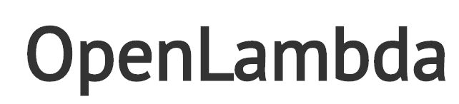



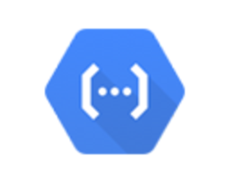



(Some) Current Platforms for Serverless
AWS Lambda
Azure Functions
Kubernetes
IBM Cloud Functions
Red-Hat
Google Functions
Notes:
Auth0, Twitter, ..
And many more upcoming / open source

Slide 47
Let’s Build a Lambda Function
We are going to do it manually to understand the process/steps.
There are several more complete approaches:
Pipelines
Serverless Framework (https://www.serverless.com/framework/docs/providers/aws/guide/intro)
AWS Toolkit for PyCharm (https://aws.amazon.com/pycharm/)
We will explore some of these ... ...

Slide 48
Putting Some Pieces Together
48 | E6156 – Topics in SW Engineering: Lecture 6: Middleware, APIGW, Lambda, SSO, Events © Donald F. Ferguson, 2021

Slide 49
Projects
/Users/donaldferguson/Dropbox/00NewProjects/SimpleMiddlerware
/Users/donaldferguson/Dropbox/00NewProjects/slack-lambda/hello_world/slack_connector.py
E6156-Student-Event Lambda function via Lambda Console
/Users/donaldferguson/Dropbox/00NewProjects/google_login

Slide 50
ETag, Conditional Update
50 | E6156 – Topics in SW Engineering: Lecture 8: CloudFront, Certificates, Composition, Step Functions © Donald F. Ferguson, 2021

Slide 51
REST and Isolation: Read then Update Conflict
Some
Resource
1. Bob GETs the resource.
3. Bob changes the data based on values.
2. Mary GETs the resource.
If
The written value
Depends on the read value.
The resource may be in the wrong state at the end.
The execution was RRWW
But the intent was RWRW.
4. Mary changes the data based on values.

Slide 52
Isolation/Concurrency Control
This requires conversation state, which would violate the REST Stateless principle.
There are two basic approaches to implementing isolation
Locking/Pessimistic, e.g. cursor isolation
Optimistic: Before committing, each transaction verifies that no other transaction has modified the data it has read.
How does this work in REST?
The server maintains an ETag (Entity Tag) for each resource.
Every time a resource’s state changes, the server computes a new ETag.
The server includes the ETag in the header when returning data to the client.
The server may optionally maintain and return “Last Modified” time for resources.
Semantics on updates
If-Match – value of a previous calls ETag response used with a PUT or DELETE. Server should only act if nobody else has modified the resource since you last fetched it. Otherwise provides a 412.
If-Modified-Since – value of a previous Last-Modified response used with a GET. Server should only provide a response if the resource was modified since the timestamp submitted. Use in conjunction with If-None-Match in case the change occurred within the same second. Otherwise provide a 304.
If-None-Match – value of a previous calls ETag response used with a GET. Server should only provide a response if the ETag doesn’t match, i.e. the resource has been altered. Otherwise provide a 304.
If-Unmodified-Since – value of a previous Last-Modified response used with a PUT or DELETE. Server should only act if nobody else has modified the resource since you last fetched it. Otherwise provides a 412

Slide 53
Hands-On CloudFront DNS, Certificate, HTTPS
53 | E6156 – Topics in SW Engineering: Lecture 8: CloudFront, Certificates, Composition, Step Functions © Donald F. Ferguson, 2021

Slide 54
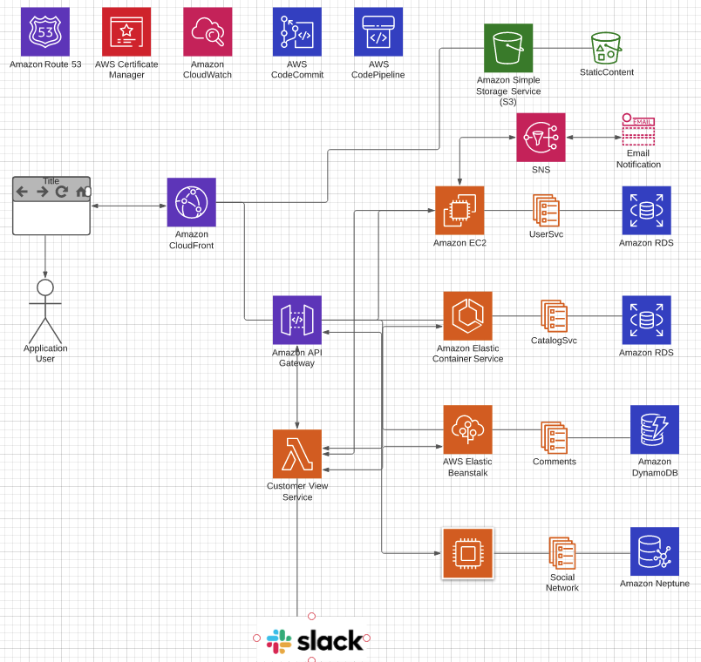
Overall Architecture
There may be multiple
Microservices
Web UI projects/content
CloudFront
Multiple S3 content → one site.
Forward API requests to API GW
API GW manages/monitors APIs
Networking/HTTPS requires
Domain, DNS
Certificates

Slide 55
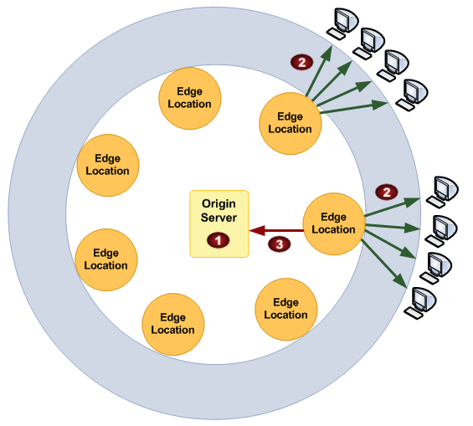
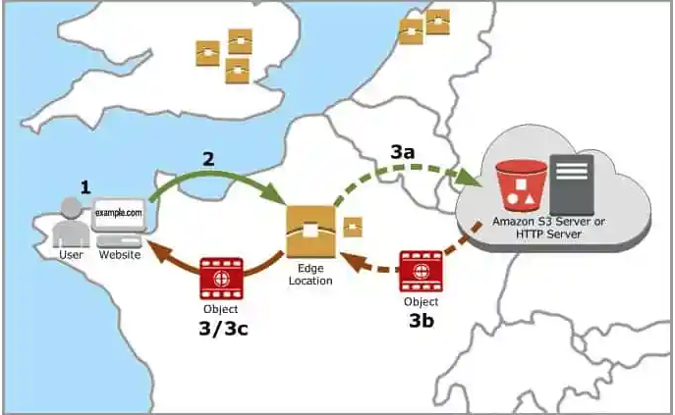
CloudFront
“A content delivery network, or content distribution network (CDN), is a geographically distributed network of proxy servers and their data centers. The goal is to provide high availability and performance by distributing the service spatially relative to end users.” (https://en.wikipedia.org/wiki/Content_delivery_network)

Slide 56
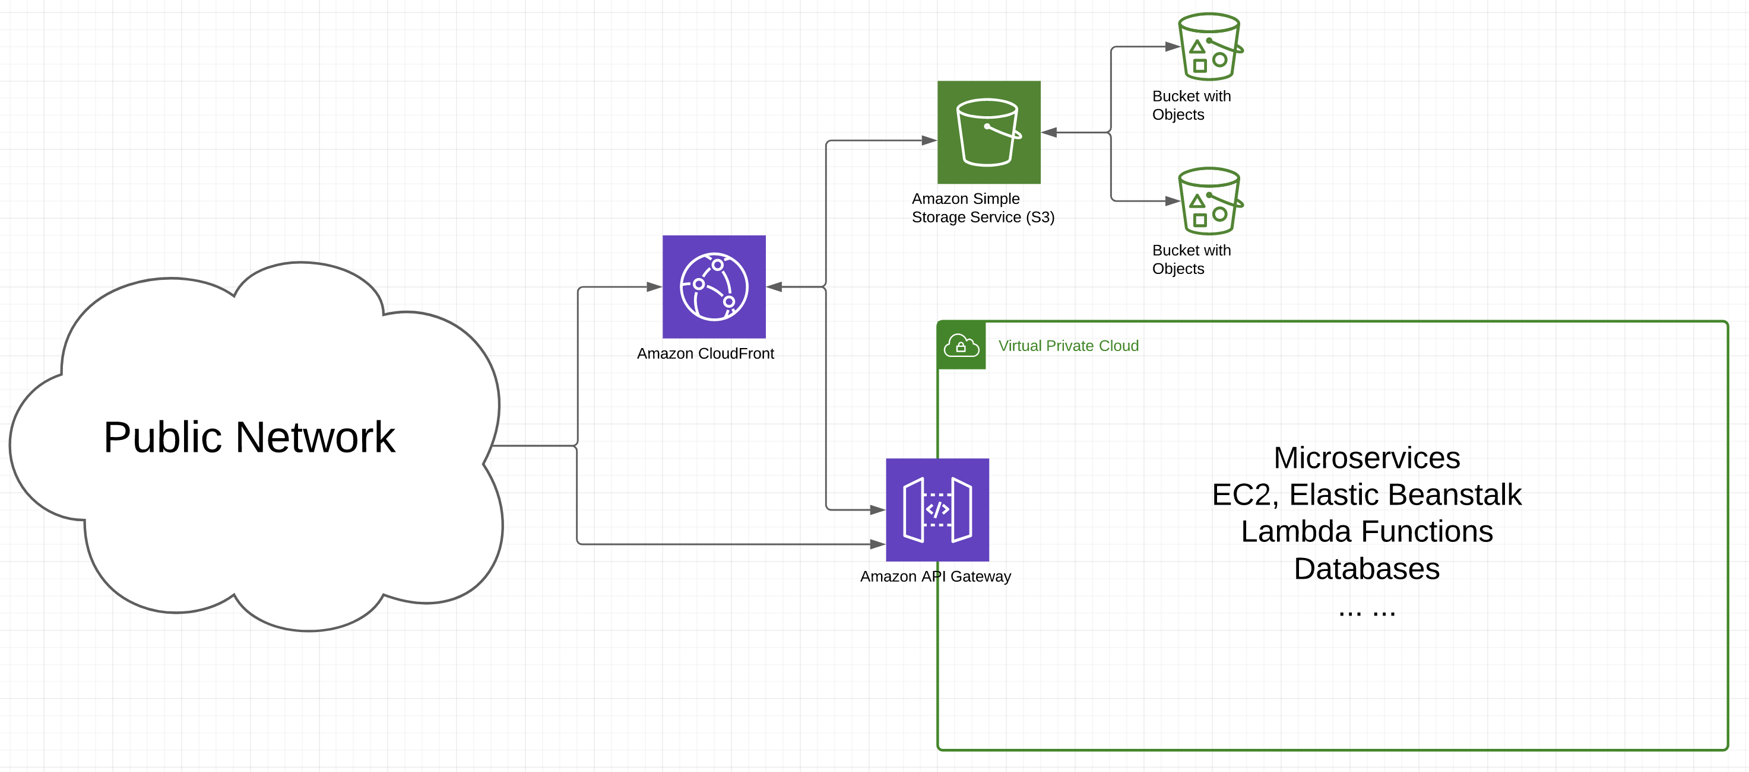
Big Picture

Slide 57
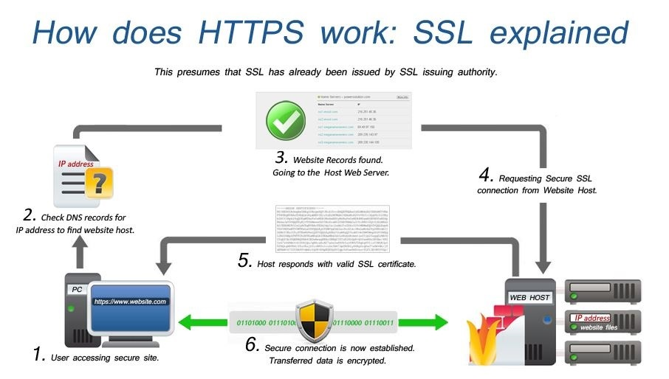
Certificates and HTTPS

Slide 58
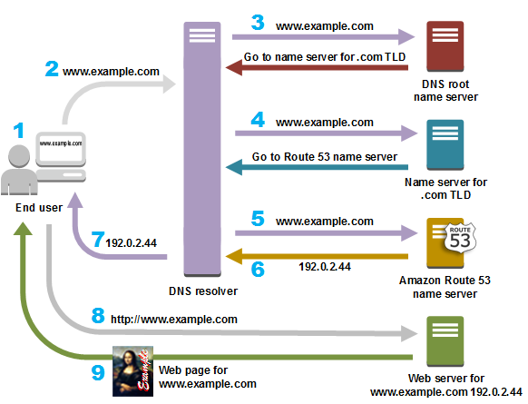
DNS

Slide 59
Things to Demo
CloudFront:
Distributions, Origins, Behavior
Monitoring, caching, alarms, ... ...
Certificates
AWS implementation
Use in CloudFront and elsewhere
Visibility in browser, HTTPs
Route 53
Proving ownership
Records

